Slide 1

Lunchtime Learners
February 2024
Ben Salisbury, Customer Success

Slide 2

February 2024
New Staff Hub App
Changing pay rates & revaluing shifts
Automating Bank Holiday rates of pay
New Functionality
💡 What should we cover next?
Email feedback@rotamaster.co.uk with your suggestions

Slide 3

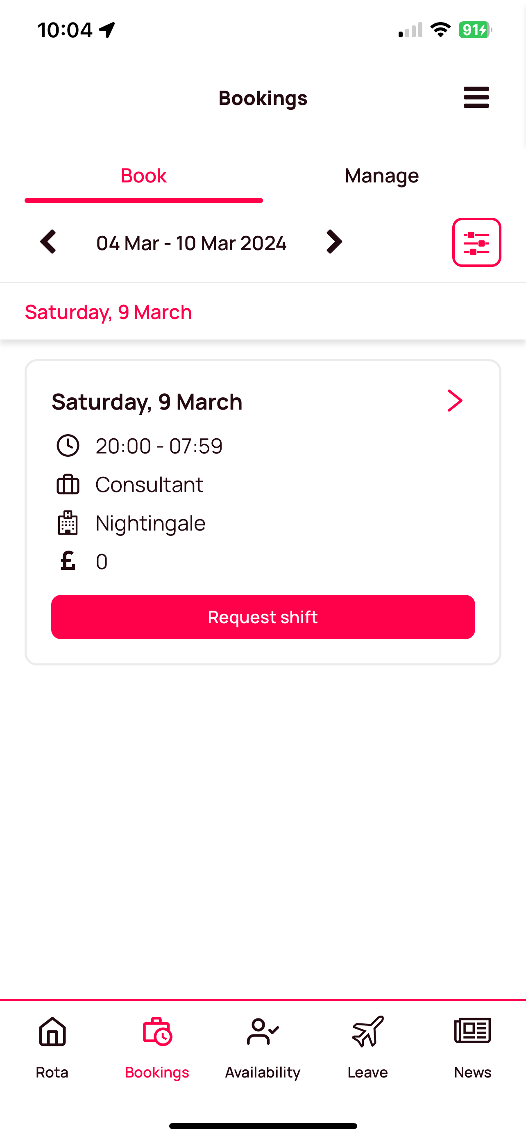
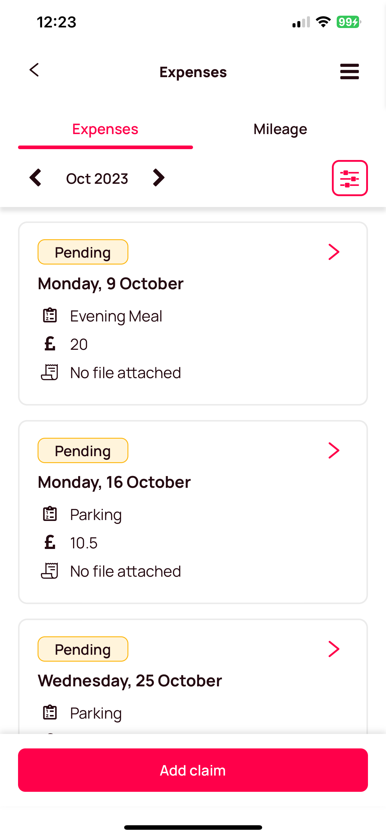
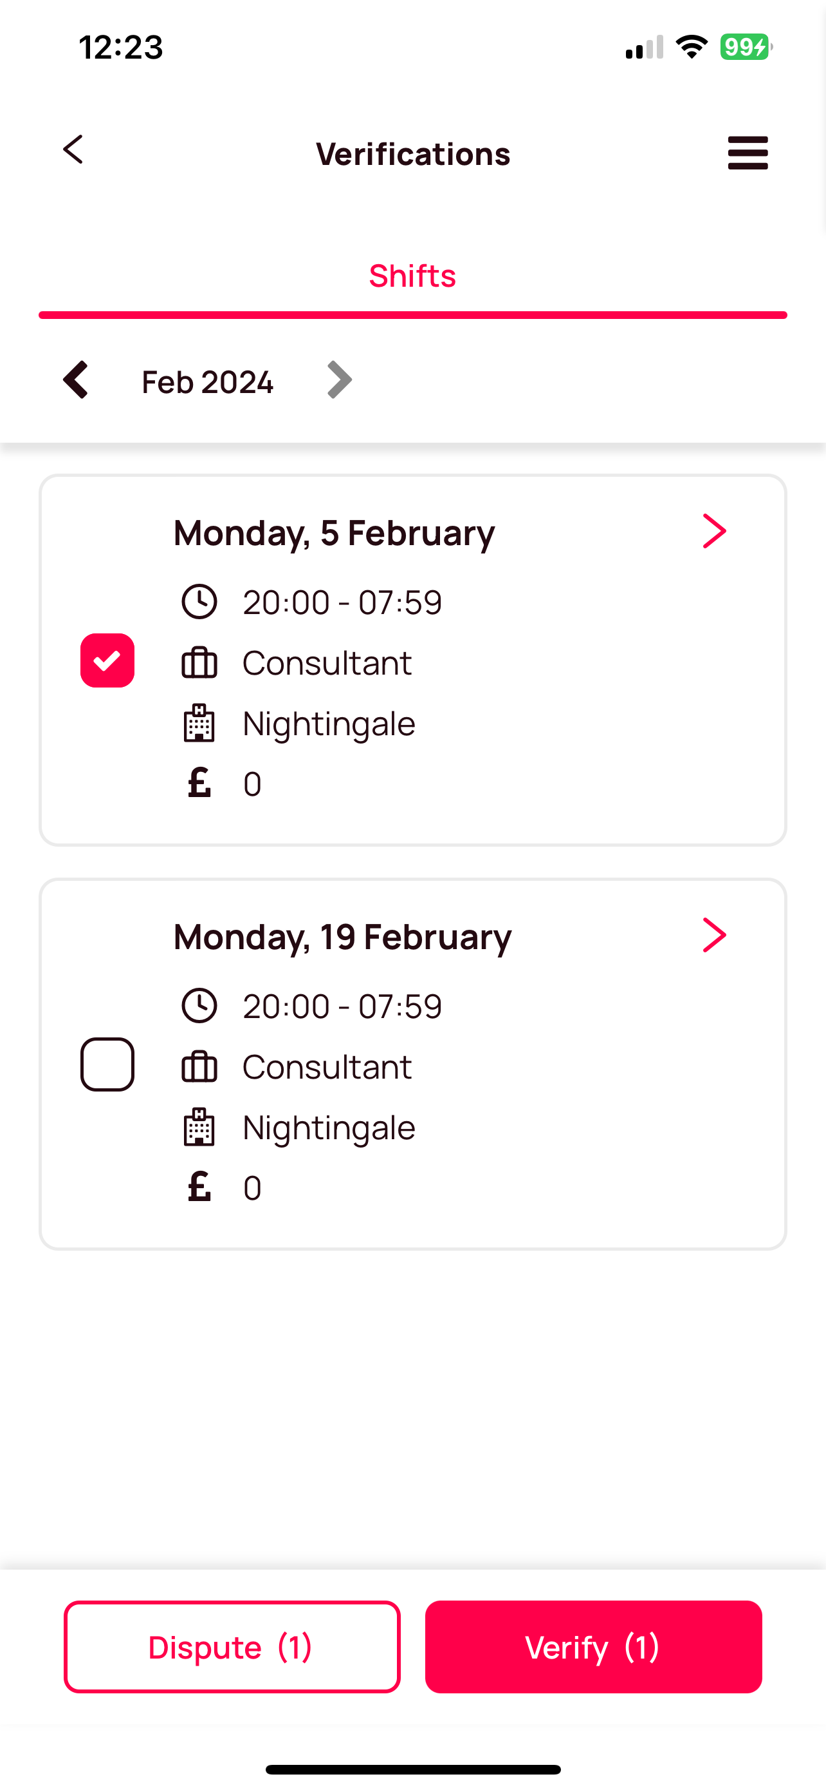
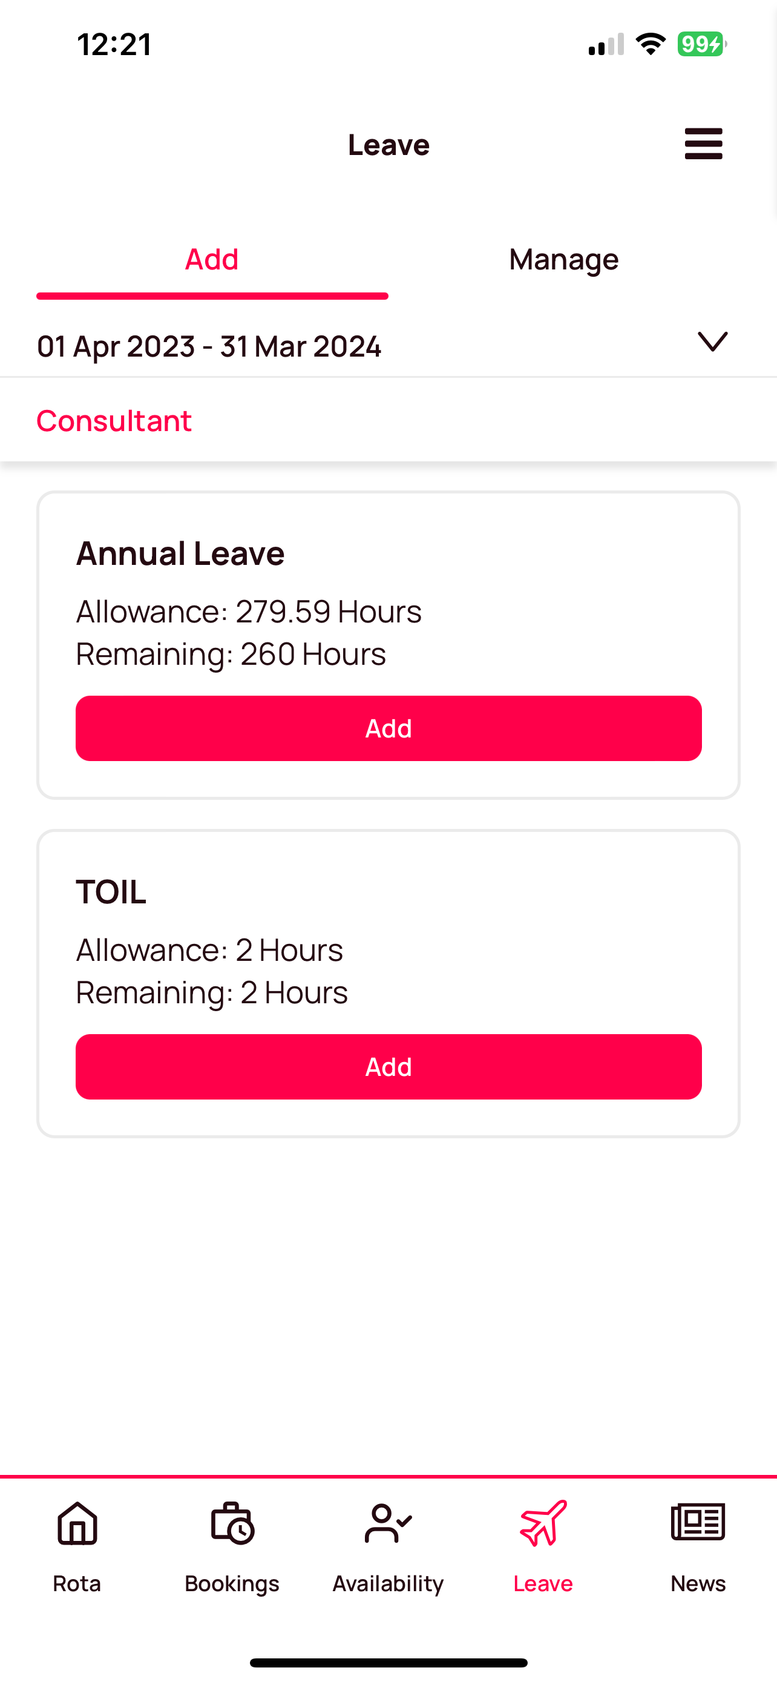
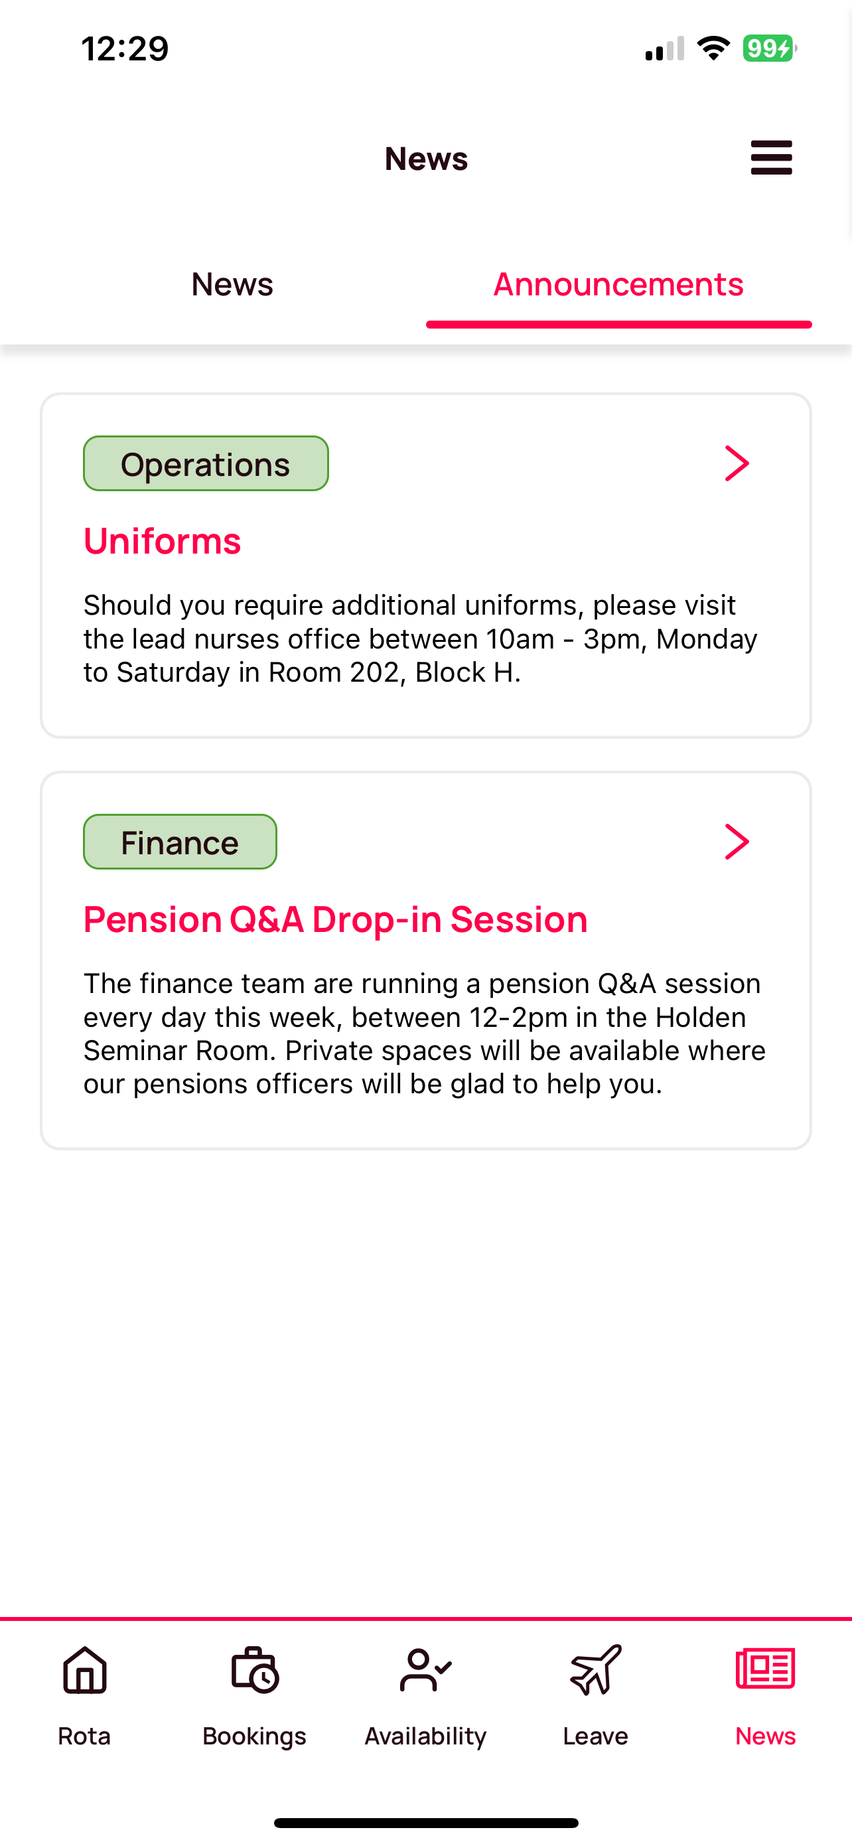
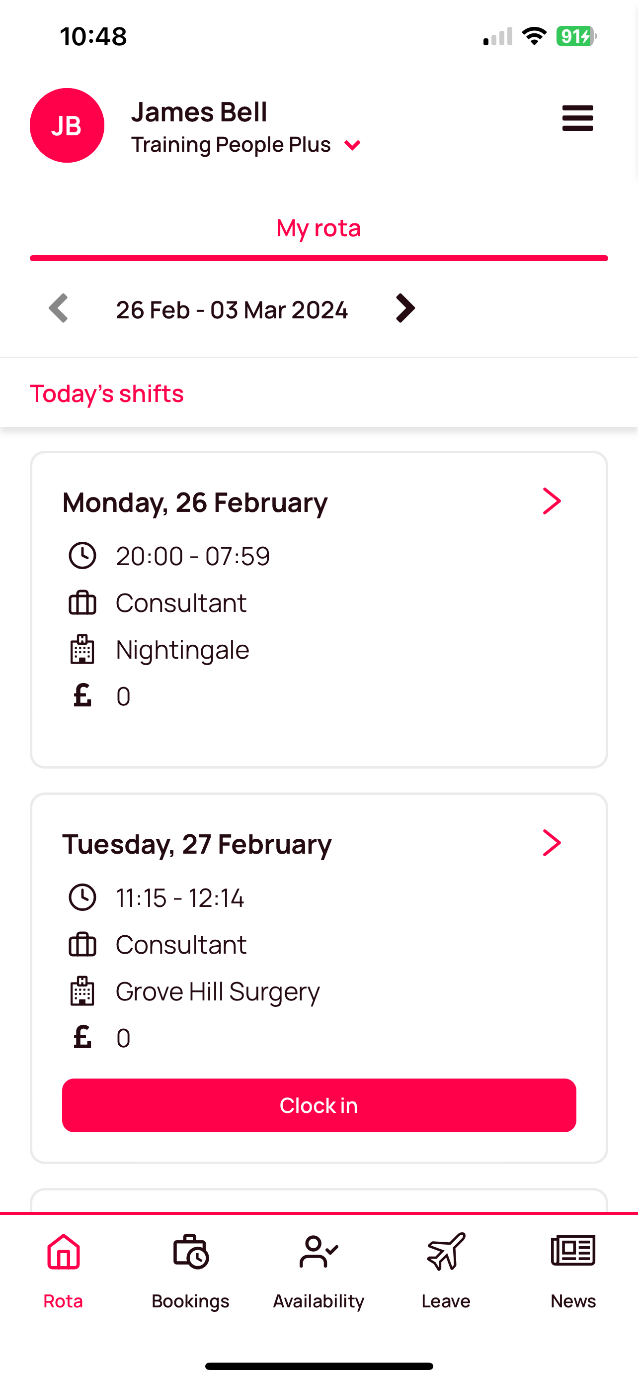
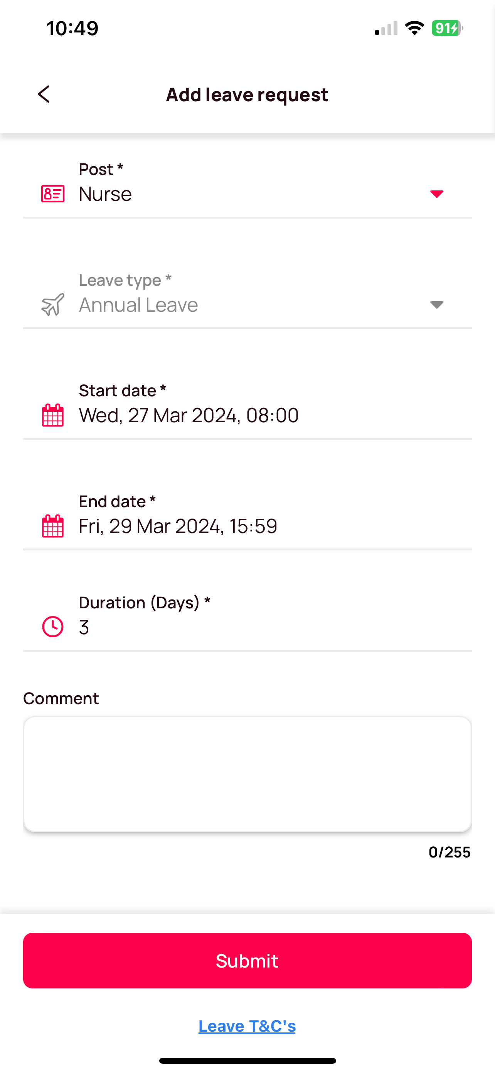

New Staff Hub Mobile App
Ease of Use… The app is now more user-friendly, ensuring a seamless and intuitive experience.
Effortless Navigation… instantly switch between organisations within the app to view & book available shifts.
Manage availability… share when you are available to work, submit leave requests & view your sickness records.
Real-time attendance data… clock into your shift from the app, once you’ve arrived on site.
Streamlined claims… submit overtime, expense & mileage claims on the go

Slide 4

Changing pay rates & revaluing shifts
How to action a pay rise within RotaMaster
To automate this process, we’ll use the set new rates feature in our pay rate group.
Here we can specify the groups, times & zones that are changing and when they increase.
Using set new rates will automatically update the value of any rotas already created after the date specified
When do I need to manually revalue the rota & how do I use rota reprice?
There are a few scenarios when we need to use another feature, rota reprice to revalue the cost of our shifts…
One example is to update the value of shifts in Shift Pattern Manager.
Another, is if we change a pay rate group inside a pay rate pattern.

Slide 5


Automate Bank Holiday rates of pay
Bank Holidays & Special Days, how do they work…
If your shift requirements or pay rates differ on a bank holiday, we can automate this by using a Special Day in our shift pattern
Once in the rota, we can add Special Days to our pay rate patterns & allocate the relevant pay rate group
RotaMaster then knows what rate to use on Monday vs. a bank holiday Monday, calculating the value automatically

Slide 6
New Functionality
📂 Export Pay Rate Groups (i130)
There is now a button that allows you to export a spreadsheet detailing all the information about your pay rate groups.
🔢 Department Number now visible when viewing a rolled-out rota (i130)
Department numbers of shifts added in shift pattern manager, can now be viewed and amended when editing a shift in your live rota.
👩‍🏫 Mandatory Training updates (i130)
Mandatory training requirements added at the company or post level, can now be removed at an individual level in their personnel profile

Slide 7

Thank you

