Slide 1

Lunchtime Learners
November 2023
Ben Salisbury, Customer Success

Slide 2

November 2023 Highlights
Tools & tips to monitor staffing levels
Sickness Management – Part 1 (People+)
Emergency Contacts
New Functionality
💡 What should we cover next?
Email feedback@rotamaster.co.uk with your suggestions

Slide 3
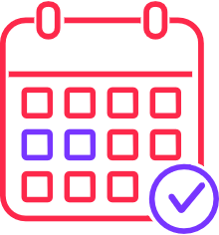

Tools & tips to monitor staffing levels
In the rota…
Quick Stats: shift durations, values, allocated vs. unallocated based on your existing filters
Statistics View: high level overview on the distribution of shifts based on your shift groups
Leave & Sickness: retain visibility of your rota & staff currently on leave or off sick, all in one view
Visualisation…
Rota Dashboard: a graph of allocated vs. unallocated shifts by zone; duty station; role or team
Personnel Dashboard: a graph of staff working; not working; on sick or on leave
Staffing Dashboard: a graph of the number of staff working across a 24-hour period
Automated notifications…
Person removed from high priority shifts
Below Shift Group Threshold: an email will be sent if the number of shifts falls below x

Slide 4
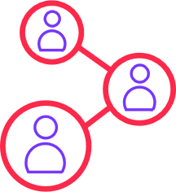

Sickness Management – Part 1 (People+)
Recording new episodes of sickness
There are two ways to log a new episode of sickness. The first, is by removing the individual from the rota & recording sickness when prompted... The second, is to create the episode in Self Service > Sickness Management, which in turn, will remove the individual from any overlapping shifts.
Extending an existing episode of sickness
Similarly to logging new sickness, existing episodes can be extended both within the rota & within Sickness Management, by removing someone from their next shift or by updating the expected last day.

Slide 5
Sickness Management – Part 1 (People+)
Actioning sickness episodes, once staff have returned to work
Once returned to work, your next step will be to enter the actual last day of sickness, for that episode in sickness management.
You will then see what needs to be completed for that episode of sickness based on your organisations policies & how RotaMaster has been configured for you, including:
Self Certification; Fit Notes; Return to Work Interview & Long Term Sickness Review
What are the requirements for sickness episodes?
To check the number of days required for each element of a sickness episode to be necessary, go to Configuration > Default Settings > Defaults

Slide 6
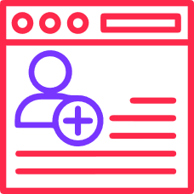
Emergency Contacts
How to add emergency contacts to personnel records…
To add emergency contacts to a member of staff’s personnel record, go to Personnel > Personnel Manager > search for & open their record > Emergency Contacts
If you would like to use a Data Loader to upload this information in bulk, please email help@rotamaster.co.uk
Viewing my emergency contacts & how to enable self service…
A member of staff can view the emergency contacts added against their record, by signing into the Staff Hub & going to Self Service > Profile > Emergency Contacts
To enable the ability for your staff to add & amend this themselves, simply sign into the Admin Hub and go to Content Mgt > Member Settings > Member Profile Settings & switch emergency contacts to ON.

Slide 7
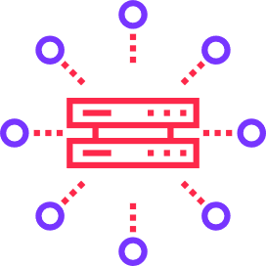
New Functionality
📘 GP Solo form for April-September 2023 (i127)
The next GP Solo form has been released & is report [857] GP Solo Form (Apr 23 – Sep 23)
📝 Audit for rules (i127)
There is now an audit available for rules created, logging what was changed, when and by who.
📅 Saved filters in Rota Weekly Viewer (i127)
RotaMaster will now remember any filters you have applied & retain these when you next open Rota Weekly Viewer.
👥 My Equality Information in the Staff Hub(i127)
Admins can now choose to make Equality Information visible in the Self Service > My Profile section of the Staff Hub. This can be enabled by going to Admin Hub > Content Mgt > Member Settings > Member Profile Settings.

Slide 8

Thank you

